Slide 1
An Interview with a Foreigner
An outreach with the Boy Scouts

Slide 2
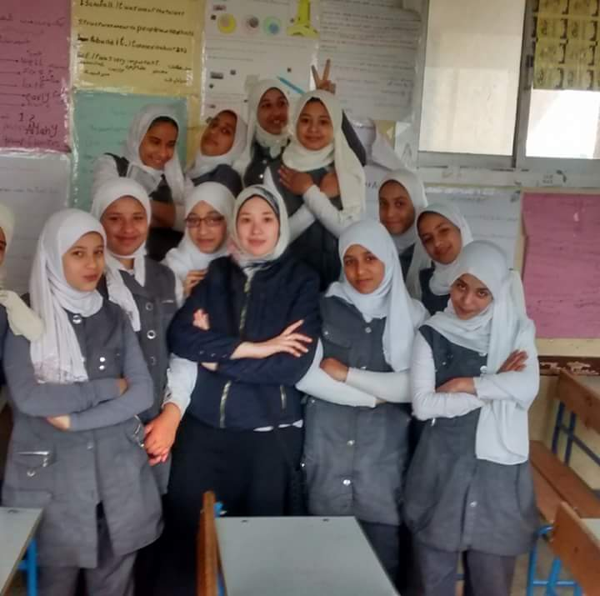
أستاذة أمانى
Ostaza Amany

Slide 3
A Greeting in Arabic
أهلا
Ah/len

Slide 4
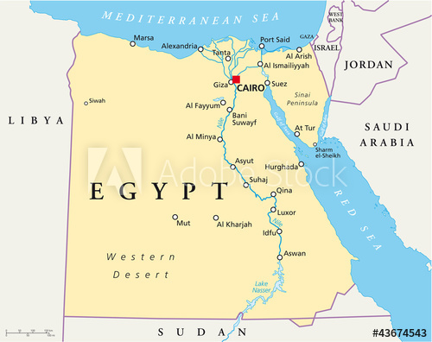
مصر
Misr

Slide 5
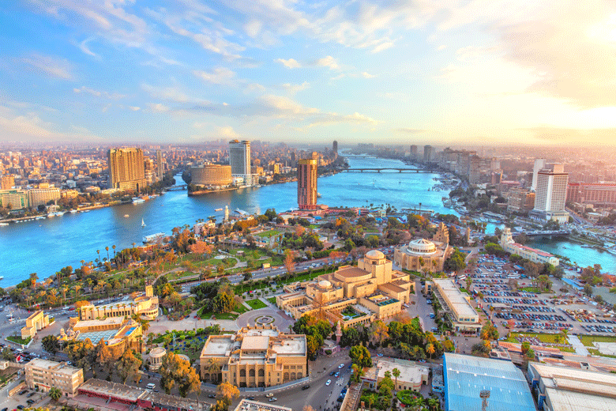
The Nile

Slide 6
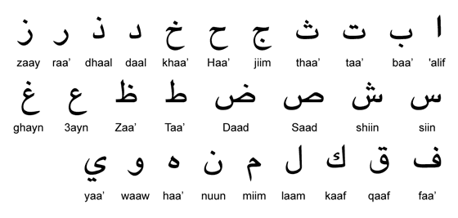
Arabic

