Slide 1
أهلا و سهلا
Bodies of Water in Africa
An Outreach in the Elementary School,
Ms. Miller Grade 2 class.

Slide 2
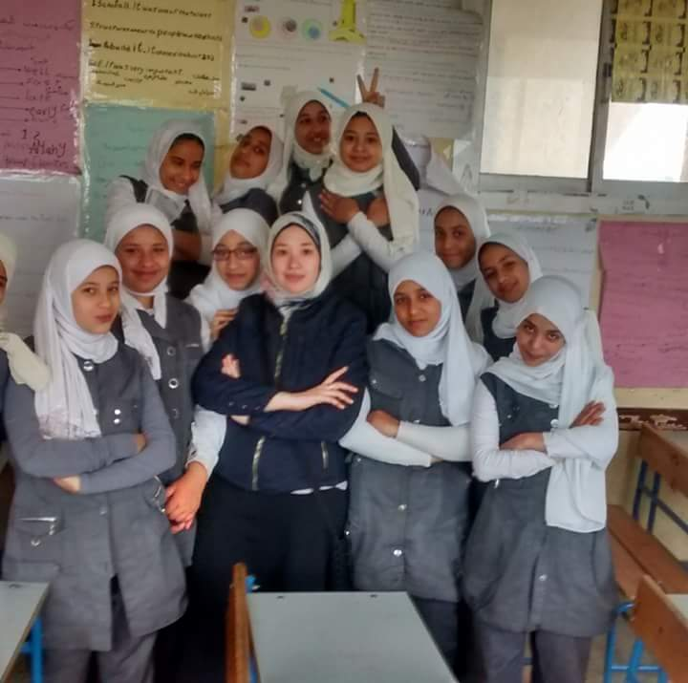
أستاذة أمانى
Ostaza Amany

Slide 3
A Greeting in Arabic
أهلا
Ah/len

Slide 4
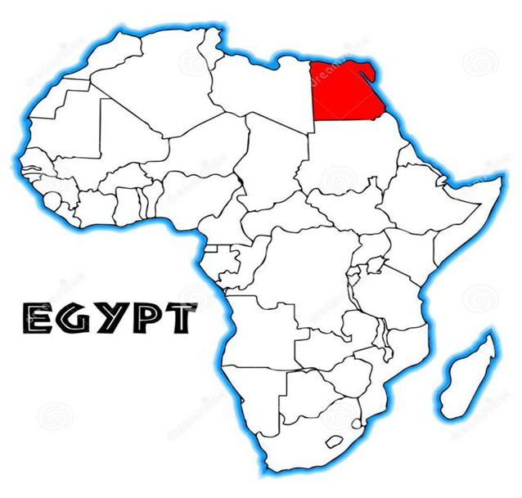
Africa

