Slide 1
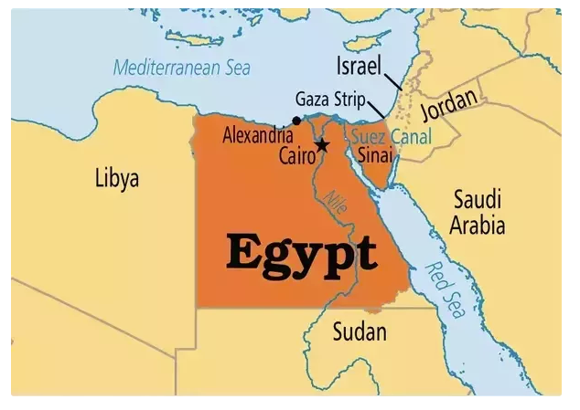

Slide 2
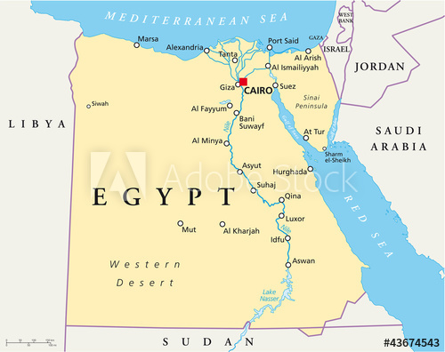
Notes:
A river delta is a landform that forms at the mouth of a river, where the river flows into anocean, sea, estuary, lake, or reservoir.[1] Deltas form from deposition of sediment carried by a river as the flow leaves its mouth.Mar 31, 2015
What is the delta r

Slide 3
The Nile

Slide 4
Let’s draw the map of Egypt and locate the water resources:

