Slide 1
Happy Mother’s Day
母亲节快乐
Learn Chinese with Mrs. Chen
和陈老师一起学中文

Slide 2
wǒ ài nǐ mā ma
我爱你，妈妈！
xiè xie mā ma
谢谢，妈妈

Slide 3
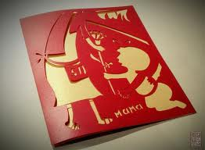
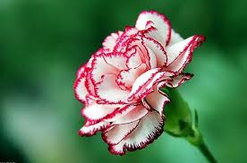
mǔ qīn jié kuài lè
母 亲 节 快 乐
Happy Mother’s Day!
kǎ piàn
卡 片
card
kāng nǎi xīn
康 乃 馨
Carnation flower

Slide 4
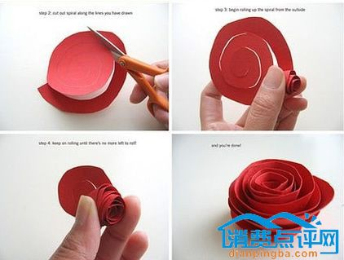
Project Time：Make a flower!
huā 花 flower

Slide 5
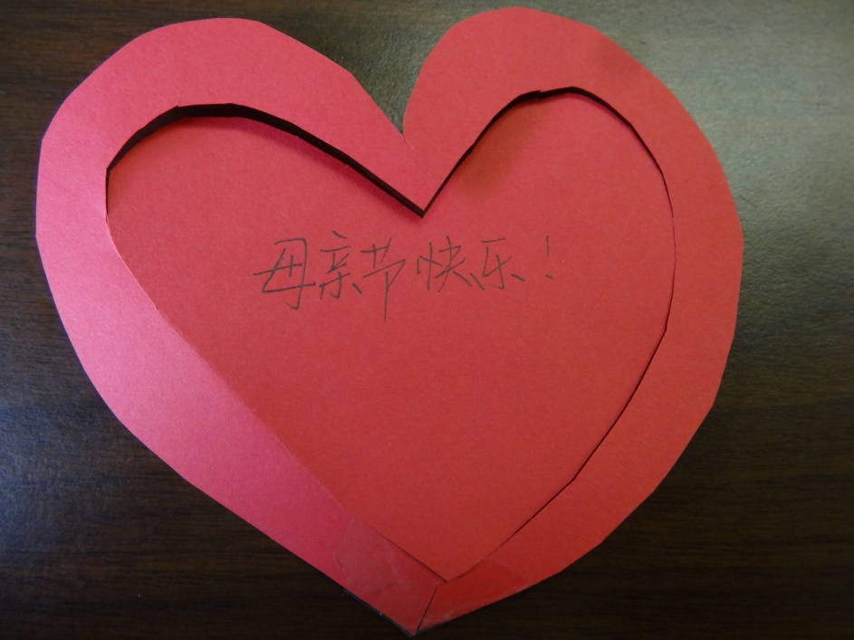
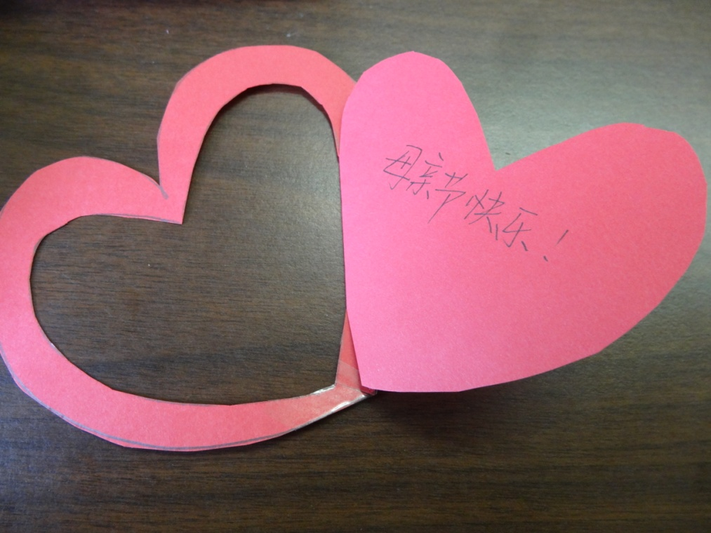
Project Time
kāi xīn kǎ piàn
开心卡片
Happy card
(开open 心heart)

Slide 6
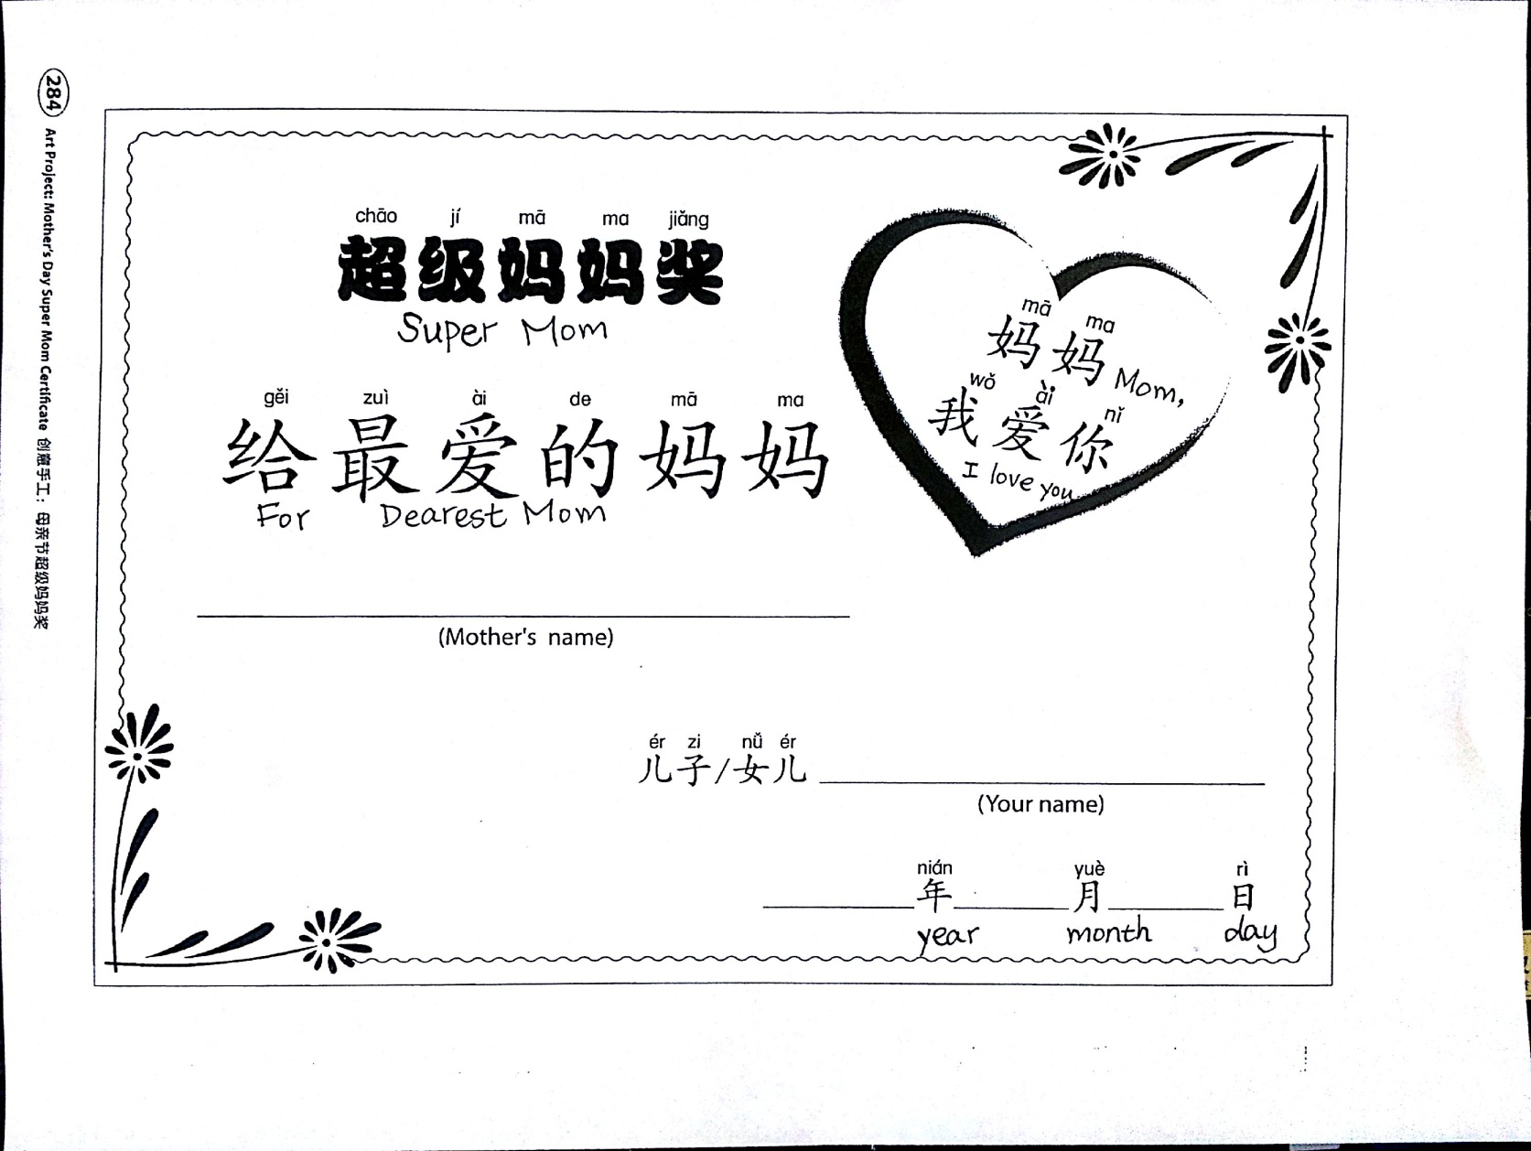
Project Time: Super Mom Certificate

Slide 7
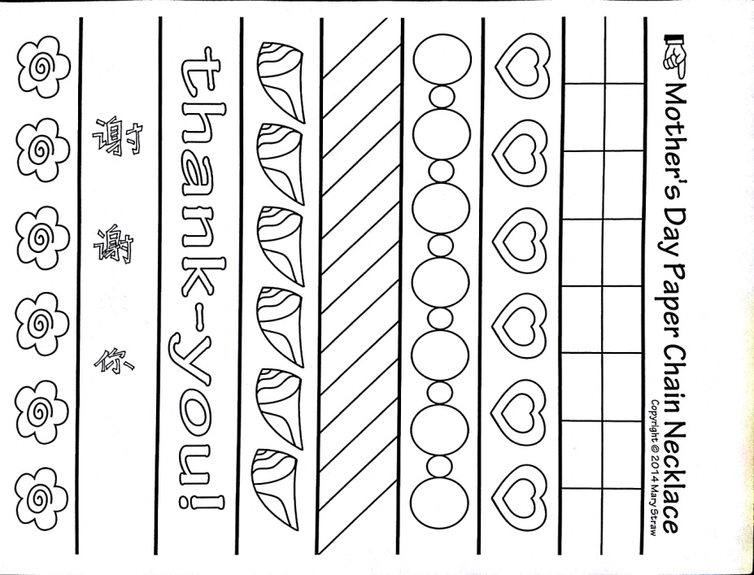
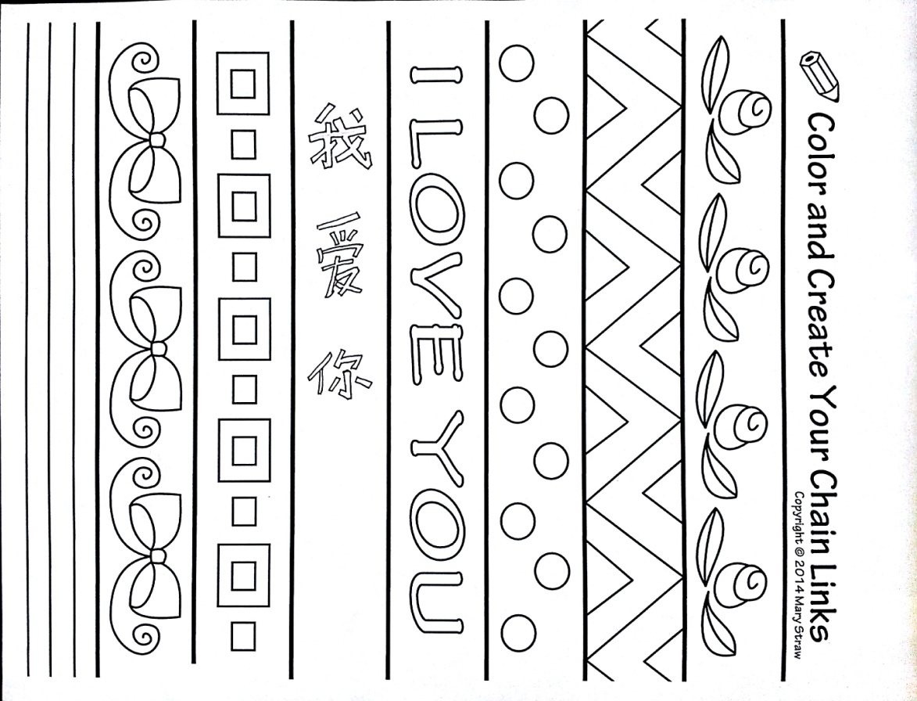
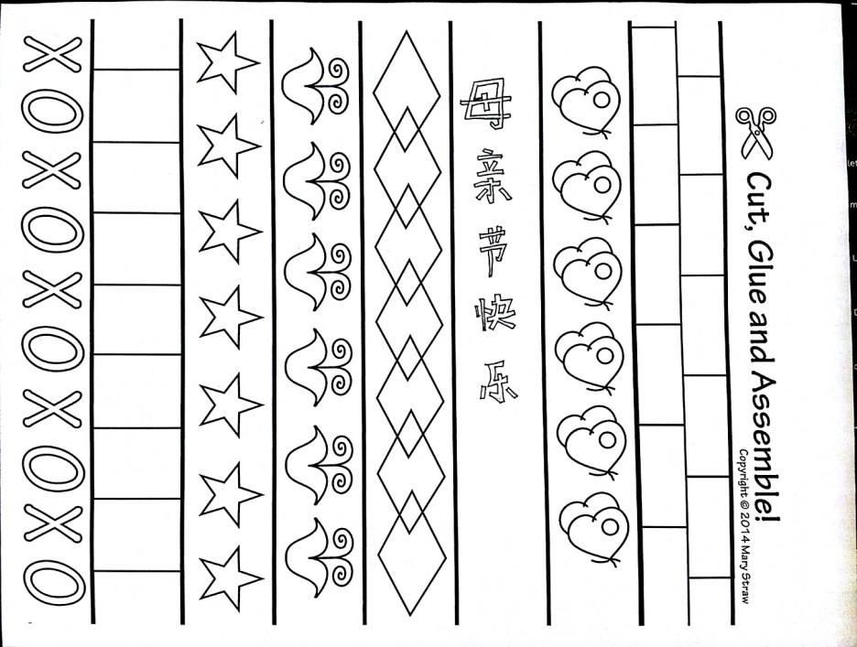
Project Time: Paper Chain Necklace

Slide 8
听妈妈的话
Listen to Mom’s Words
Tīng mā ma de huà, bié ràng tā shòu shāng.
听妈妈的话, 别让她受伤.
Listen to mom's words, don't let her get hurt.
Xiǎng kuài kuài zhǎngdà, cái néng bǎo hù tā.
想快快长大, 才能保护她. ...
Want to grow up quickly, be able to protect her.
Měi lì de bái fà, xìng fú zhōng fā yá,
美丽的白发, 幸福中发芽.
Beautiful white hair, sprouting in happiness.
Tiān shǐ de mó fǎ, wēn nuǎn zhōng cí xiáng.
天使的魔法, 温暖中慈祥.
Angel's magic, benevolent in kindness.

