Slide 1
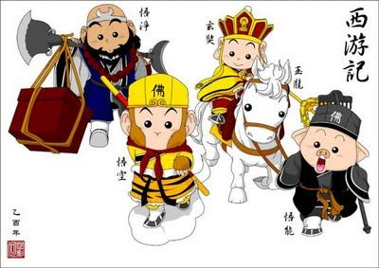
和陈老师一起学中文
Learn Chinese with Mrs. Chen
Journey to the West

Slide 2
西游记
Xī Yóu Jì
西 = West
游 = Journey
记 = Record
Journey to the West

Slide 3
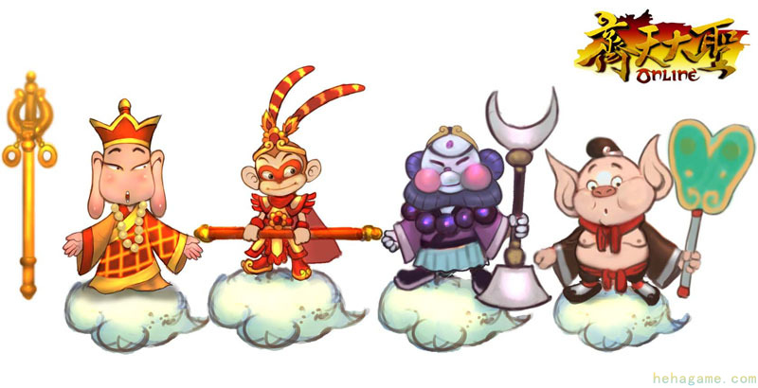
Main Characters
sūn wù kōng
孙 悟 空
Monkey King
táng sēng
唐 僧
Monk Tang
shā sēng
沙 僧
Monk Sha
zhū bā jiè
猪 八 戒
Pigsy

Slide 4
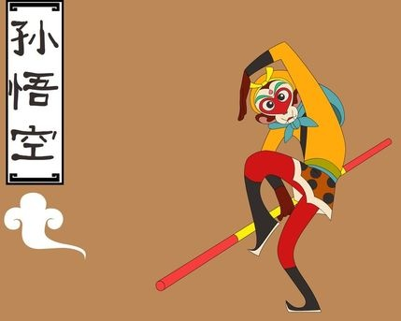
Monkey King is no ordinary monkey. He can change into any shape and he can fly to heaven on a cloud. He stores a magic rod in his ear (that can change sizes) and uses it to defeat the nastiest ogre in battle. The story of Monkey King has been read and loved by Chinese children for hundreds of years.

Slide 5
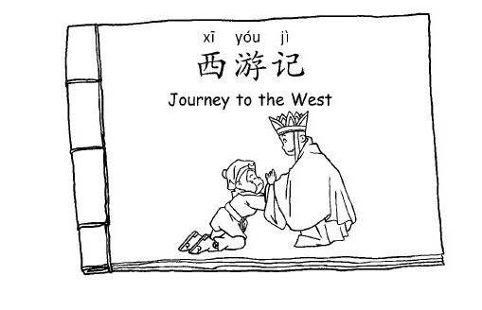
Story Time

Slide 7
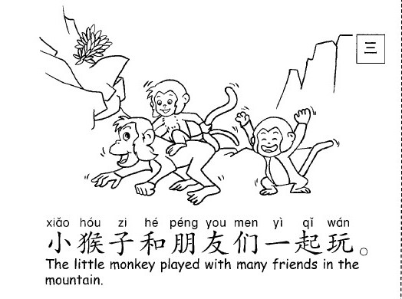

Slide 8
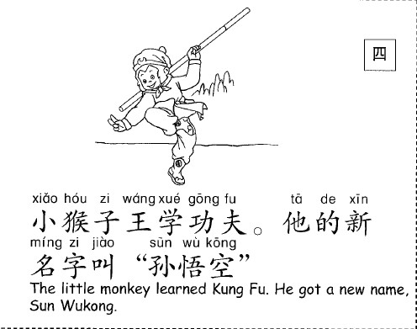

Slide 9
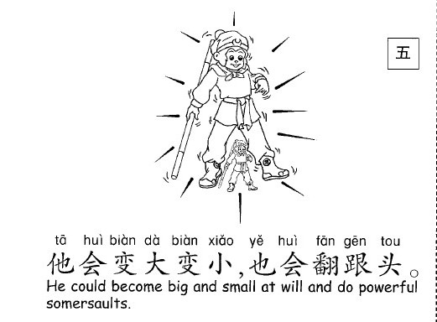

Slide 10
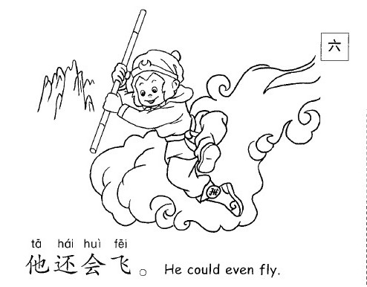

Slide 12
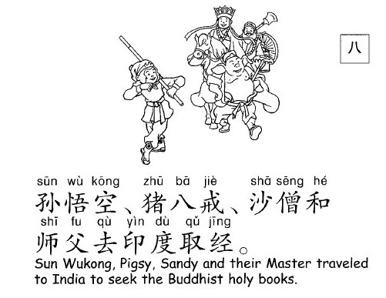

Slide 14
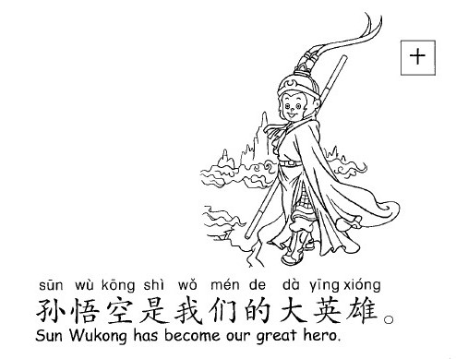

Slide 16
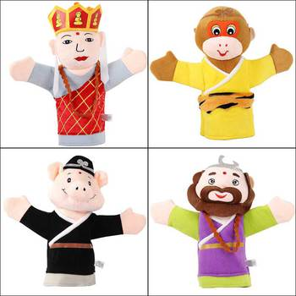
Choose one character and practice the dialog in Chinese with your partner.
Dialog:
nǐ hǎo
A: 你 好！（Hello!)
nǐ hǎo
B: 你 好！(Hello!)
nǐ jiào shén me míng zì
A:你 叫 什 么 名 字？
(What’s your name?)
wǒ jiào sūn wù kōng
B:我 叫 孙 悟 空。
(My name is Monkey king.)
nǐ ne
你 呢?(What about you?)
wǒ jiào shā sēng
A: 我 叫 沙 僧。
(My name is Monk Sha)
táng sēng
唐 僧
Monk Tang
sūn wù kōng
孙 悟 空
Monkey King
shā sēng
沙 僧
Monk Sha
zhū bā jiè
猪 八 戒
Pigsy

Slide 17
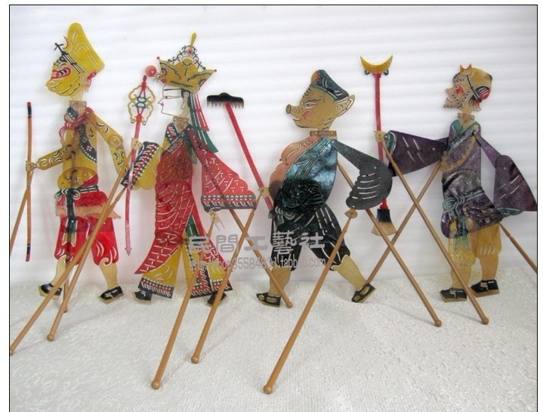
Choose one character and practice the dialog in Chinese with your partner.
皮影戏 [pí yǐng xì]
shadow play
皮影戏偶Shadow Puppet
Dialog:
nǐ hǎo
A: 你 好！（Hello!)
nǐ hǎo
B: 你 好！(Hello!)
nǐ jiào shén me míng zì
A:你 叫 什 么 名 字？
(What’s your name?)
wǒ jiào sūn wù kōng
B:我 叫 孙 悟 空。
(My name is Monkey king.)
nǐ ne
你 呢?(What about you?)
wǒ jiào shā sēng
A: 我 叫 沙 僧。
(My name is Monk Sha)

