Slide 1
The Future Job of the American High School and college/university Students

Slide 2
Do the American students have to do part time jobs?

Slide 3
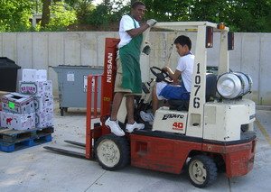
The American high school students have to do a lot of part time jobs.

Slide 4
Finance problems
Tuition
Buying personal items
Daily spending
Other programs

Slide 5
Other reasons
The American parents are much less involved in the students’ schooling
The American high school students have to figure out what they want to be in their lives all by themselves
The American high school students have to earn the pocket money all by themselves

Slide 6
What do the take to make money?

Slide 7
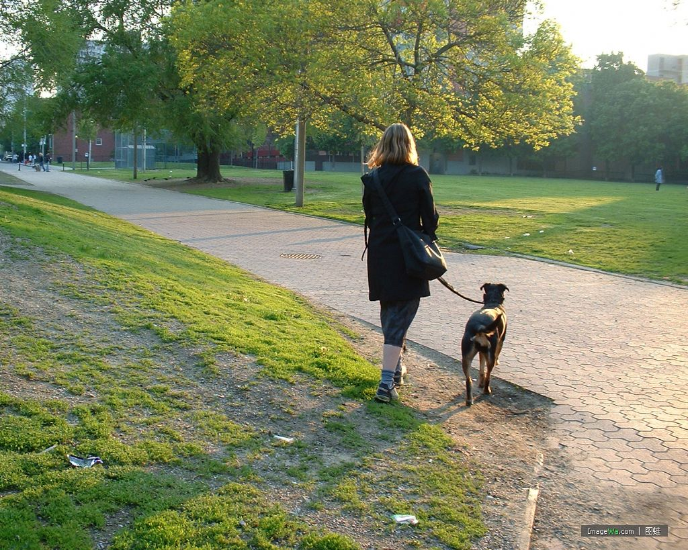
part time jobs.

Slide 8
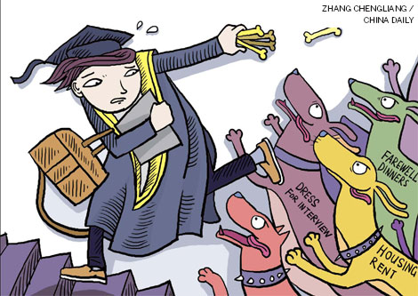
The American college/university students still have to do a lot of part time jobs.

Slide 9
Good sides of the students part time jobs
it gains experience for them, good for them to easily get into another new job;
it is also helpful to them to figure out what is their dream job, so they can actually saving time in job-hunting and job-jumping;
it is also some good thing to be put into their future resume in finding jobs;

Slide 10
Who do the grads turn to in finding jobs?

Slide 11
The tips
In the colleges/universities, they have career center
They make surveys to the grads to help them know themselves better
Every department has their own Employment Guidance Center
Each year the U.S. department of labor publishes a thick book of position requirements manual

Slide 12
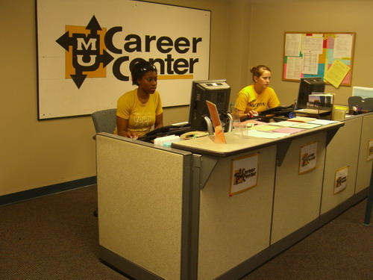
career center

Slide 13
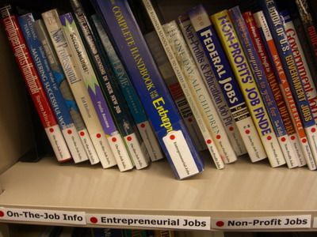
Yearly position requirements manual

Slide 14
U.S. department of labor website
http://online.onetcenter.org/

