Slide 1
Feelings By: Ahmed Mohamed
Watertown Middle school
TCLP 2014- 2015

Slide 2
Objectives: By the end of the lesson the students will be able to:
Know how to talk and express their feeling sin Arabic.
فرحان – فرحانة
زعلان - زعلانة
غضبان- غضبانة
عطشان – عطشانة
جوعان – جوعانة
نعسان - نعسانة
مندهش – مندهشة
They will ask and answer questions about others feelings.
كيف تشعر اليوم؟
أنا فرحان اليوم.
كيف حالك اليوم؟
أنا زعلان اليوم.
Talk about a picture and describe people’s feelings in pictures
هو زعلان
هي زعلانة

Slide 3
Warm up 5 minutes
The teacher asks the students the following questions. They have already studied this before.
كيف حالك اليوم؟ أنا بخير
كيف حال أبوك؟ أبي بخير
كيف حال أمك؟ أمي بخير

Slide 4
Presentation 15 minutes
The teacher presents the feelings in Arabic with pictures and words on the PowerPoint. He gets the students read, say and write the words. Then he asks them to put the words in small sentences like
انا فرحان
انا زعلانة
هو جوعان
هي عطشانة

Slide 5
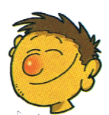
فرحان -فرحانة

Slide 6
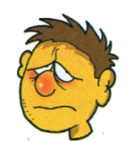
زعلان- زعلانة

Slide 7
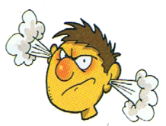
غضبان - غضبانة

Slide 8
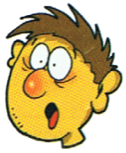
مندهش- مندهشة

Slide 9
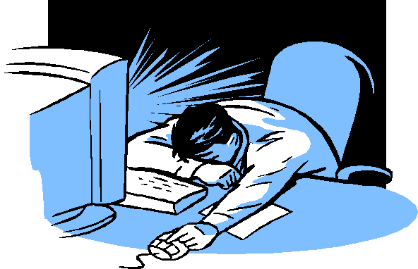
نعسان- نعسانة

Slide 10
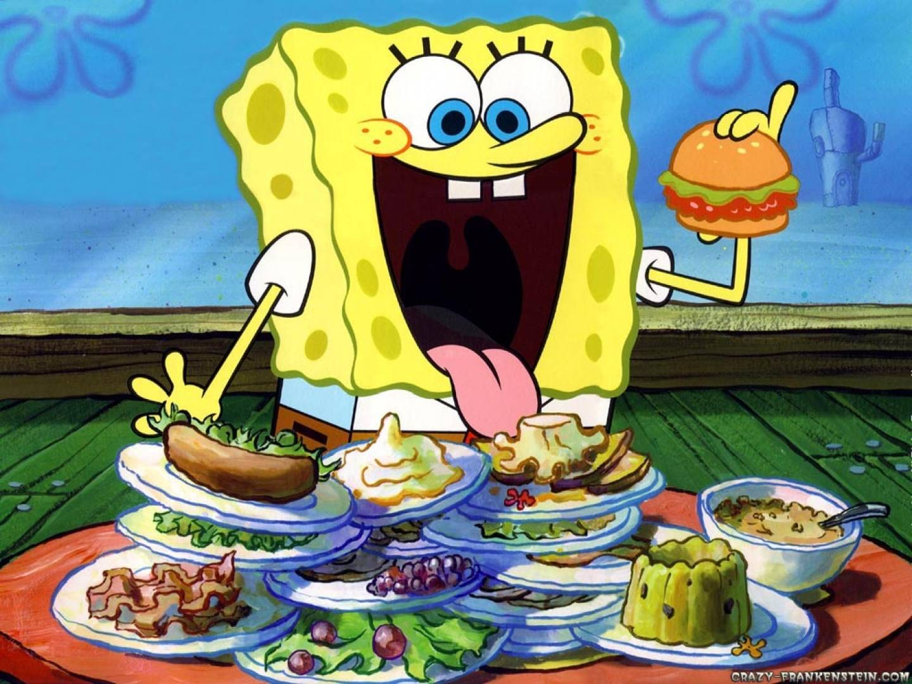
جوعان - جوعانة

Slide 11
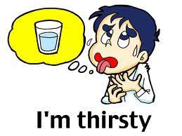
عطشان- عطشانة

Slide 12
The Silent Teacher
5 minutes
The teacher tells the students that he will silently present some pictures on the projector which represent different feelings and they will use “ Education” program on the I Pads to write what do these picture represent

Slide 13
Write and Act
5 minutes
The teacher asks the students to use” Education” program on the I pads to write what they feel right now and show their feelings through facial expressions.

Slide 14
Game
Feeling Circle
10 minutes
The teacher and the students sit in a circle and everybody introduces himself or herself. All the others say hi to him or her. Then they ask him or her about his or her feeling. If the feeling is good they clap and show happiness. If it is not they tell him or her that they are there for him or her. The conversation will be like this.
The students: Hello. I am……...........
All the students: Hello ……........How do you feel?
The students: I am sad!!!!!!!
All the students: We are her for you.
الطالب: انا اسمي ............
جميع الطلاب: مرحبا ً............ كيف تشعر؟
الطالب: انا زعلان.
جميع الطلاب : احنا معاك.

Slide 15
Feedback and Homework
The teacher asks the students to thumps up if they liked the lesson today and thumps down if they didn’t. He gives out sticky note to write one thing they liked about the class and one thing they didn't like. He asks them to take the home work sheet while leaving the class.

Slide 16
Homework
Word search 10 minutes

Slide 17
Homework 2 15 minutes Draw a picture representing your feeling now and write your feeling below the picture in Arabic ارسم صورة تعبر عن شعورك الآن

