Slide 1
Egyptian Amulets
An outreach at Ms. Dusty’s Art Classes.
The Arabic Exchange Teacher: Ms. Malek

Slide 2
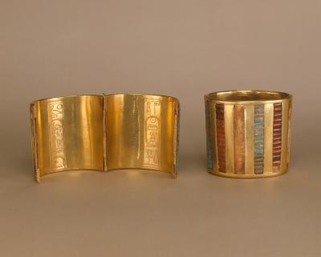
Armlets.
They can be found in The Egyptian Museum in Cairo.

Slide 3
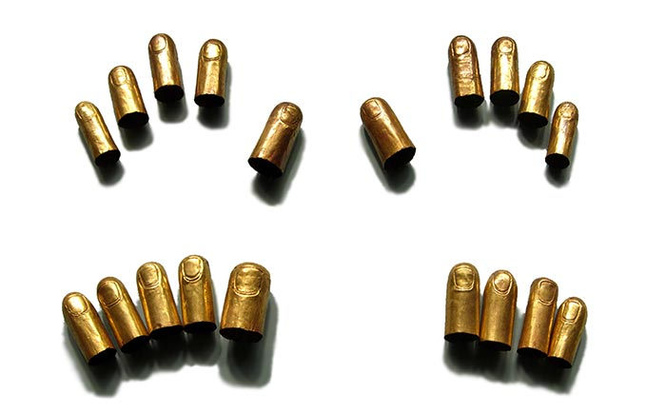
Finger Coverings

Slide 4
Amulets
1- They were abundant.
2- They were not mostly made from precious stones.
3- They were not expensive.
4- They were available to everybody.

Slide 5
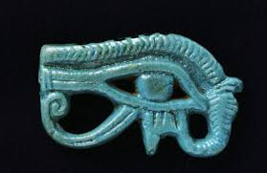
Horus Eye
Wedjat-eye

